Slide 1
Unit 2 Image Enhancement in Spatial Domain
Total Hour:7
Presented by
Er.Harendra Bikram Shah (Lecturer)
Department of Computer Engineering
NAST

Slide 2
OUTLINES
Unit 2: Image Enhancement in Spatial Domain [7 hrs]
2.1. Gray Level Transformations
2.1.1. Point operations
2.1.2. Contrast stretching,
2.1.3. Thresholding,
2.1.4. Digital negative,
2.1.5. Intensity level slicing
2.1.6. Bit Plane Slicing
2.2.Histogram Modeling, Histogram equalization, Histogram matching
2.3. Enhancement Using Arithmetic and Logic Operations
2.4. Spatial Filters
2.5. Smoothening and Sharpening Spatial Filters
2.5.1. Averaging
2.5.2. Median filtering
2.5.3. Spatial Low Pass
2.5.4. High pass filtering
2.5.5. Magnification by replication and interpolation

Slide 3
Introduction to Image Enhancement
process of manipulating digital images to improve their quality, visual appeal, or suitability for specific tasks.
Involves adjusting various aspects of the image, such as brightness, contrast, color, sharpness, and noise.
Image enhancement in the spatial domain is based on the following expression:
g(x. y) = T[f(x, y)]
where, f (x, y) is the input image, g(x, y) is the output image and T is an operator
Application of Image Enhancement
1. Medical Imaging
2. Security and Surveillance
3. Astronomy
4. Photography
5. Industrial Inspection
6. Remote Sensing and Geography
7. Forensic Analysis
8. Education and Research
9. Art and Entertainment

Slide 4
Gray level Transformations
Technique used in image processing to modify the intensity values of pixels in a grayscale image.
0 for low level or darkest level or black
127 for middle level gray
255 for white
Applications of Gray Level Transformation:
Image enhancement
Image segmentation
Image restoration
Image analysis

Slide 5
Some basic Gray level Transformations
1. Point operations/Pixel Operation:
Technique that manipulate the intensity values of individual pixels in an image without considering any neighbouring pixels
can be performed using a single image, or two images of the same size
s = T(r)
Where T is the point operator of a certain Gray-level mapping relationship between the original image and the output image.
and s, r: denote the gray level of the output pixel and the input pixel respectively.

Slide 6
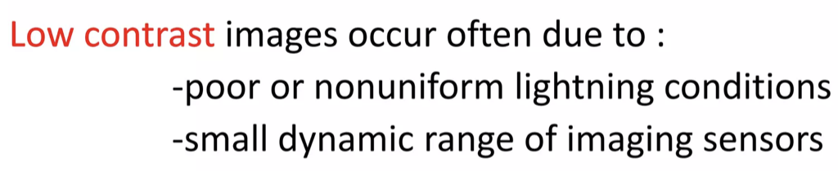
Some basic Gray level Transformations
2. Contrast Stretching:
This is to enhance the contrast between different parts of an image, that is, enhances the gray contrast for areas of interest, and suppresses the gray contrast for areas that are not of interest.
Makes darker part More-darker and Brighter part more-Brighter.
Increase the dynamic range of gray levels in the image being processed.

Slide 7
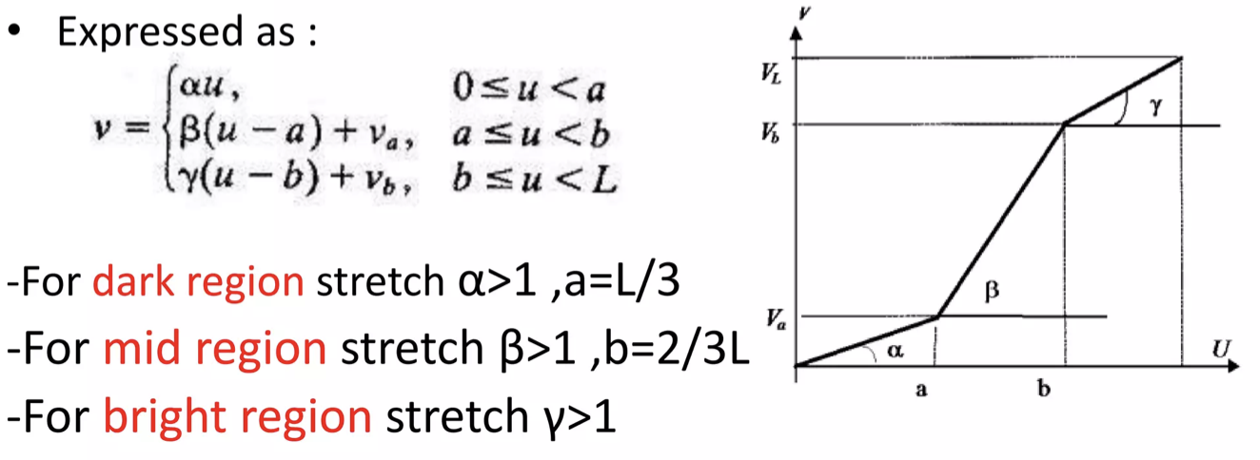
2.Contrast Stretching

Slide 8
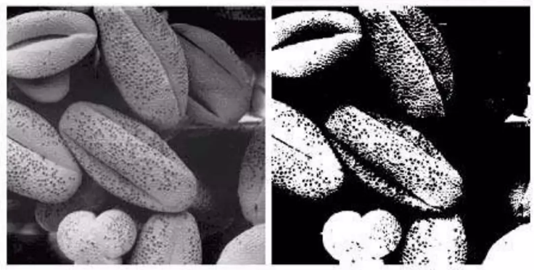
Example of Contrast Stretching

Slide 9
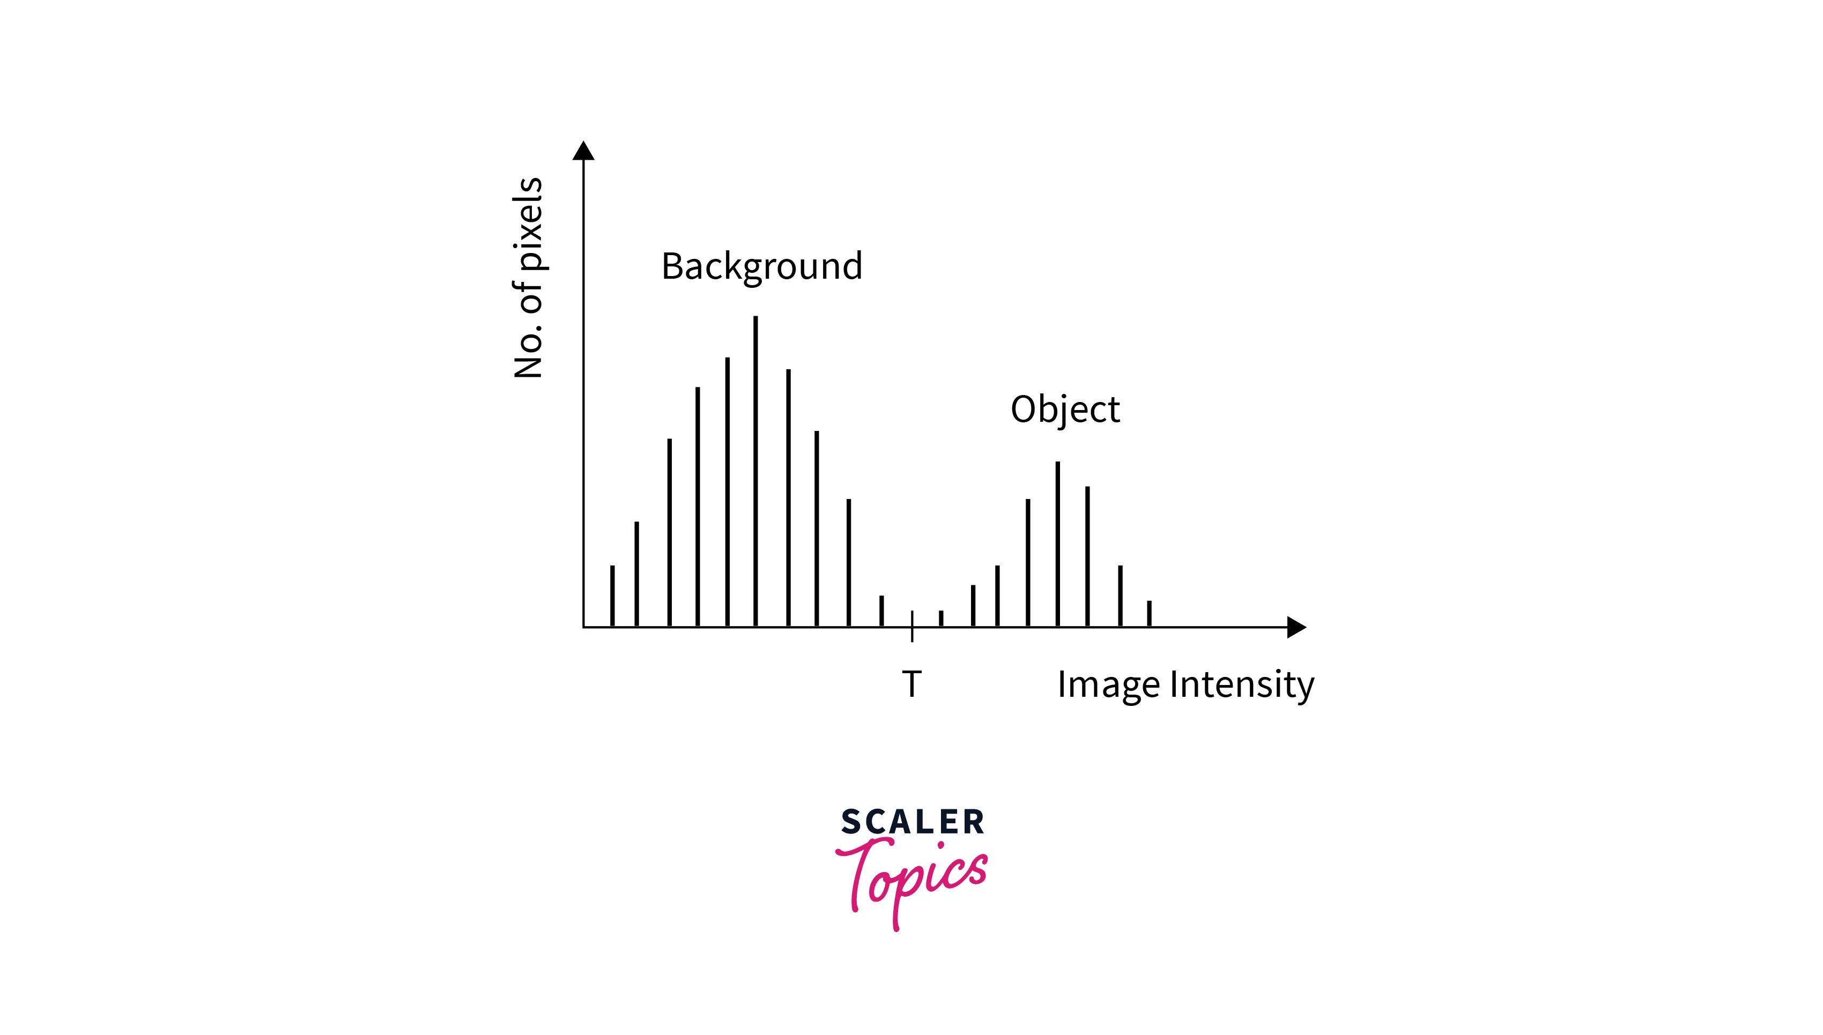
3.Thresholding
It is dividing an image into two or more regions based on intensity levels, allowing for easy analysis and extraction of desired features.
task of selecting a threshold value to separate the pixels of an image into two classes: foreground and background.
thresholding involves assigning a value of 0 or 1 to each pixel in the image, based on whether its intensity is above or below the selected threshold value.

Slide 10
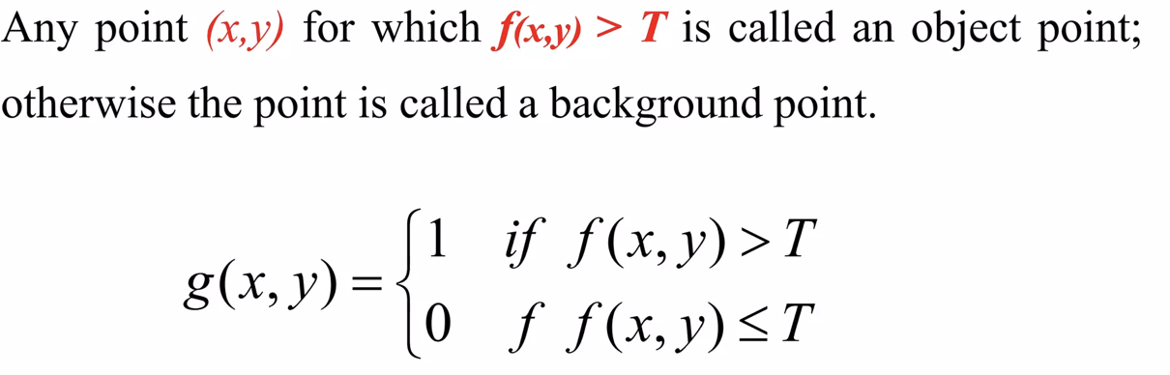
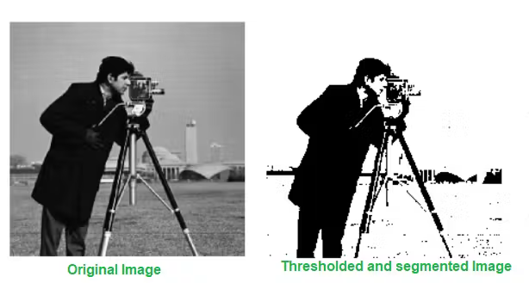
3.Thresholding

Slide 11
3.Thresholding
Pros
Simplicity:
Effectiveness:
Versatility:
Cons
Sensitivity to noise:
Difficulty in choosing the threshold:
Limitations for complex images:

Slide 12
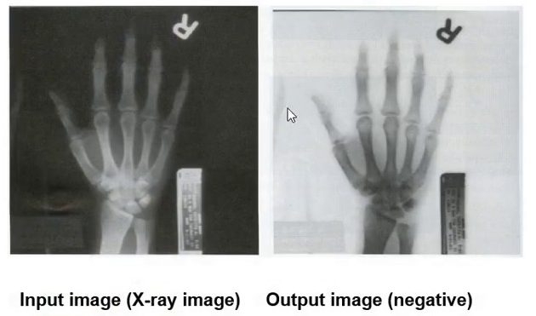
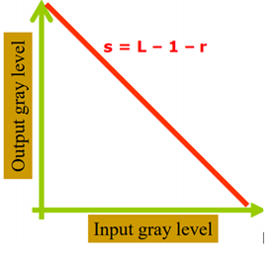
4. Digital Negative
Reversing of Gray Level results into Digital Negative
The negative of an image with intensity levels in the range of [0, L-1] is obtained by using the negative transformation given by the formula S=L-1-R.
Useful in Medical Images

Slide 13
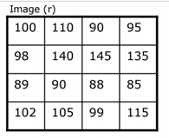
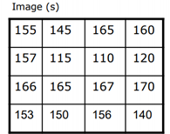
4. Digital Negative
L= 2^8 = 256
s=L-1-r
s =255-r
original image
After applying this transform to each pixel so to find the negative the transformed image is :
For r[0,0] grey level value is= 100 ; L=256 so,
s[0,0]=256–1-r[0,0],s[0,0]=255–100=155 so r[0,0]=155
Negative of the original image

Slide 14
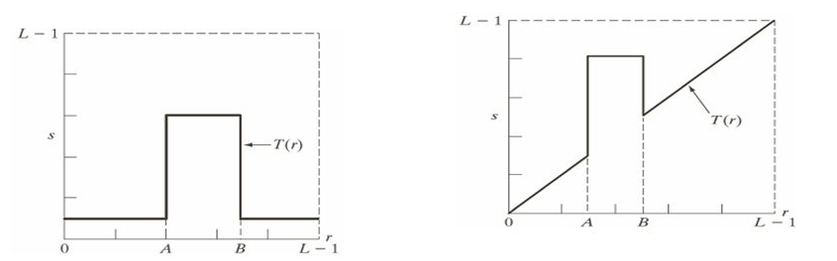
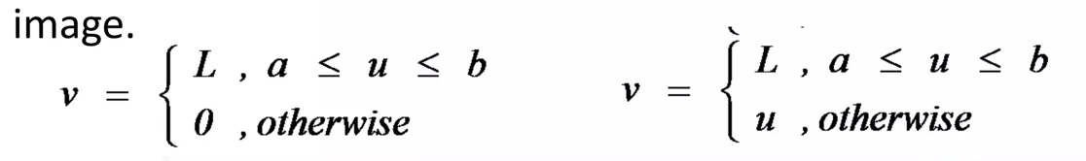
5. Intensity/Gray level slicing
Highlighting a specific range of Gray levels in an image.
Slicing without Background
Slicing with Background

Slide 15
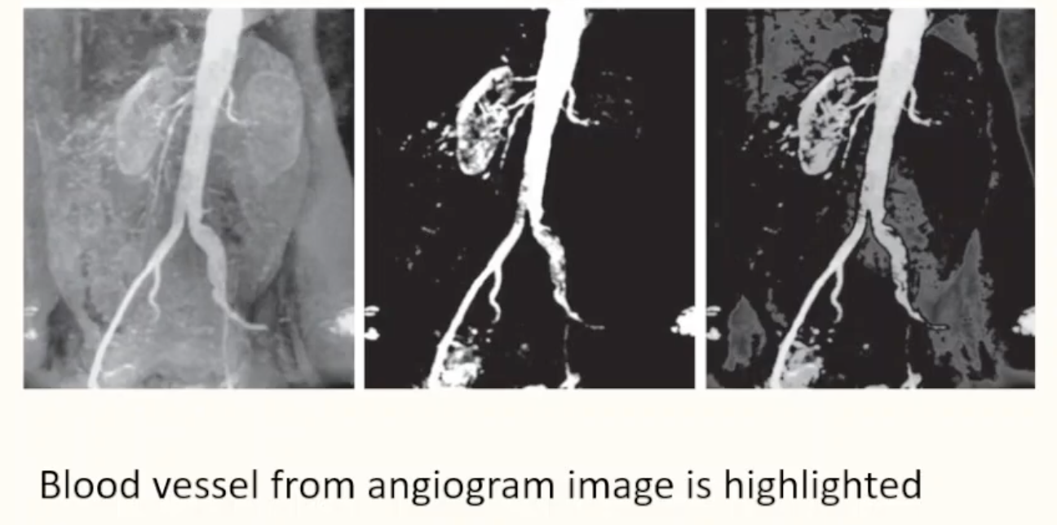
5. Intensity/Gray level slicing

Slide 16
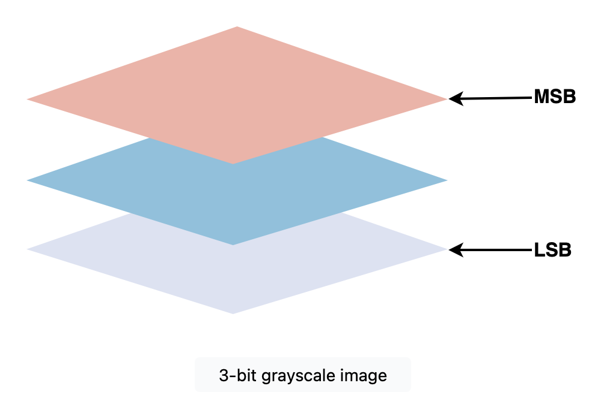
6. Bit Plane slicing
Methods to analyse the individual bits in the pixel values, where each pixel is represented by a binary number.
The process of bit-plane slicing involves separating and displaying each bit of the pixel values as a separate image.

Slide 17
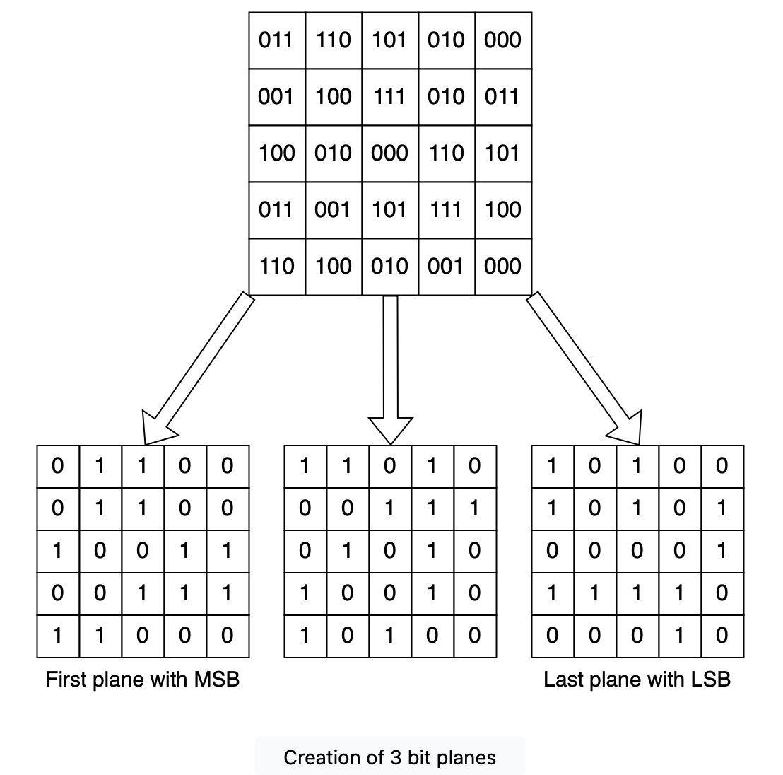
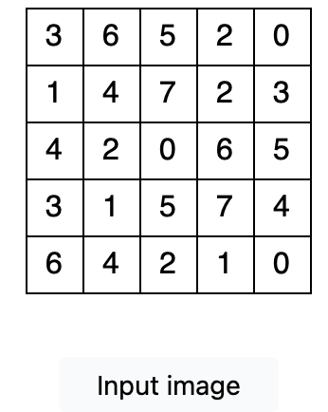
6. Bit Plane slicing

Slide 18
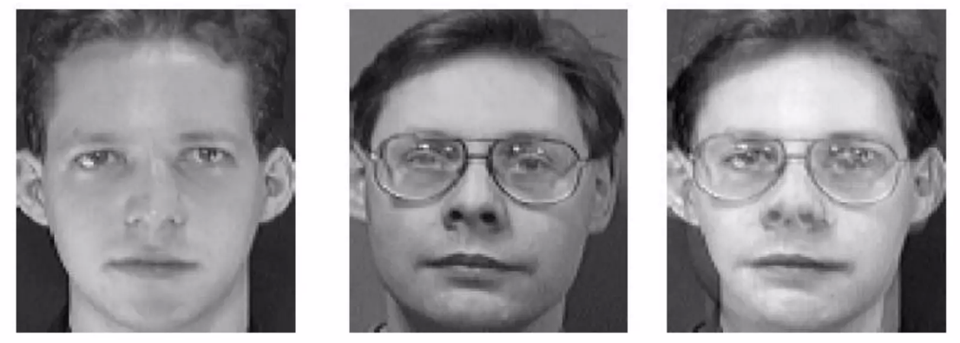
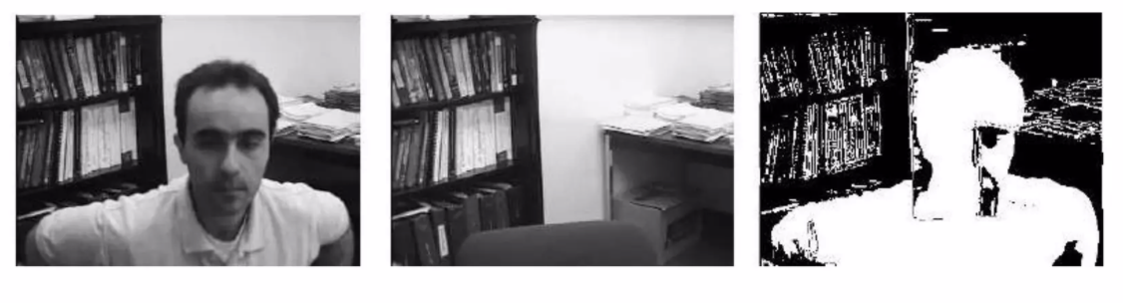
Enhancement Using Arithmetic and Logic Operations
Arithmetic operations involve manipulating pixel values by performing mathematical operations on corresponding pixels of two images.
Operations are
Addition
Subtraction
Multiplication
Division
Addition
Subtraction

Slide 19
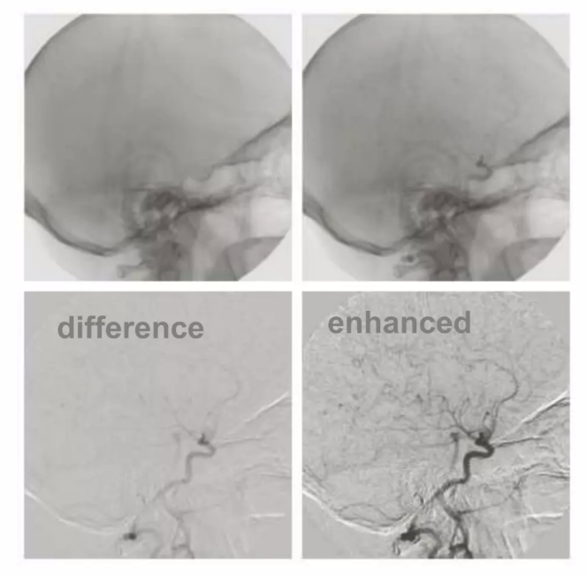
Enhancement Using Arithmetic and Logic Operations
Subtraction

Slide 20
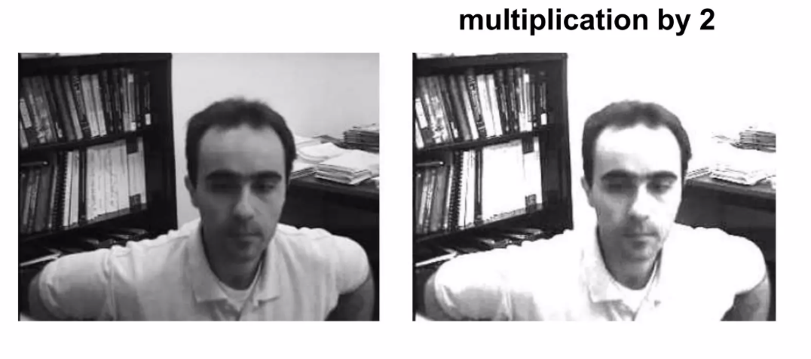
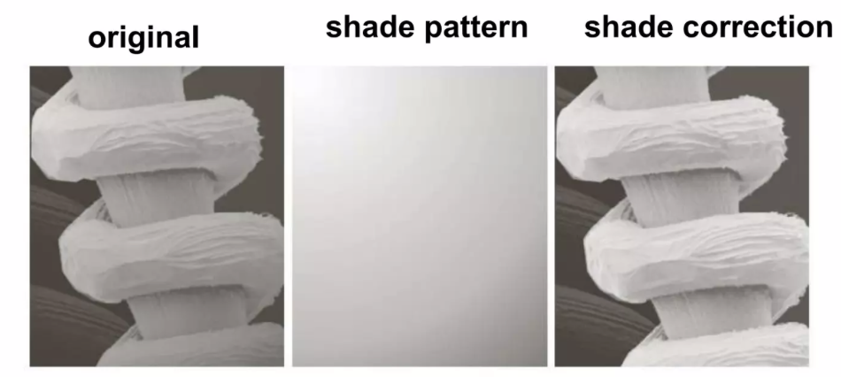
Enhancement Using Arithmetic and Logic Operations
Multiplication
Division

Slide 21
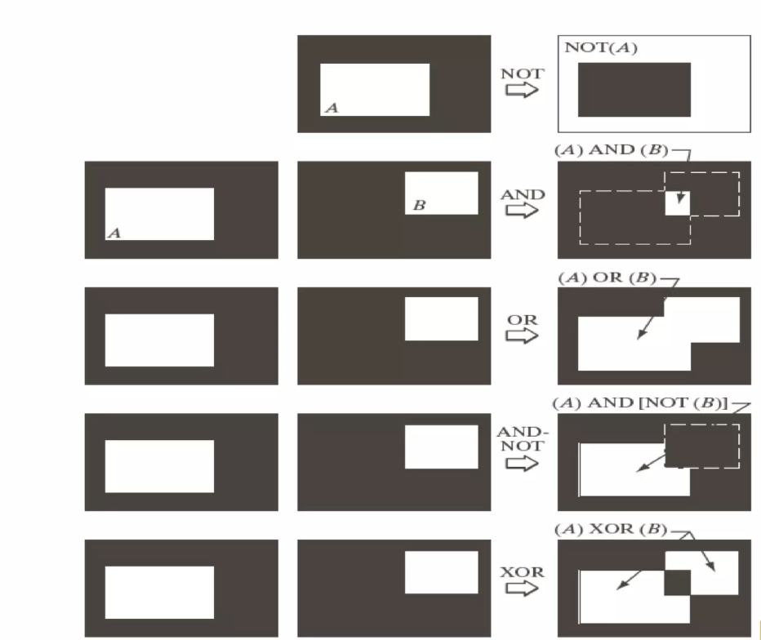
Enhancement Using Logic Operations

Slide 22
Basics of Spatial Filters
Spatial filters are techniques in image processing that modify or enhance an image by manipulating the pixel values based on the values of neighboring pixels.
The "spatial" part refers to the fact that the filter works over a local neighborhood of each pixel, not just the pixel itself.
They operate directly on the pixels of the image.
Often used for smoothing, sharpening, edge detection, noise reduction, and feature extraction.
Working
A kernel (also called a mask or filter) is moved across the image pixel by pixel:
At each pixel, the filter computes a new value based on the original pixel and its neighbors.
The kernel is typically a small matrix (e.g., 3×3, 5×5).
| 1 1 1 |
| 1 0 1 |
| 1 5 1 |
3x3 Kernel

Slide 23
Basics of Spatial Filters
Types of Spatial Filters
There are two main types:
Linear Spatial Filters
The output is a linear combination of the input pixel values.
Examples:
Smoothing filters (low-pass filters): Reduce noise and blur the image.
Sharpening filters (high-pass filters): Enhance edges.
Typical operations: Averaging, Gaussian smoothing, Laplacian sharpening.
Non-linear Spatial Filters
The output is a non-linear function of the input pixel values.
Examples:
Median filter: Replaces a pixel with the median of its neighbors.
Good for removing salt-and-pepper noise without blurring edges.
Importances Of Spatial Filters
They help in preprocessing images (denoising, blurring)
They assist in feature detection, critical in fields like computer vision, robotics, medical imaging, etc.
They allow image enhancement for better human interpretation or machine analysis.

Slide 24
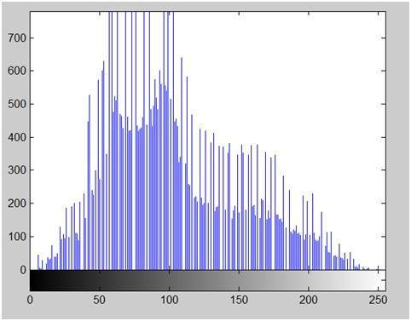
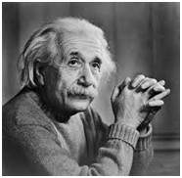
Histogram Processing and Equalization
Graphical Representation of an image .
It shows number of pixel per Gray level.

Slide 25
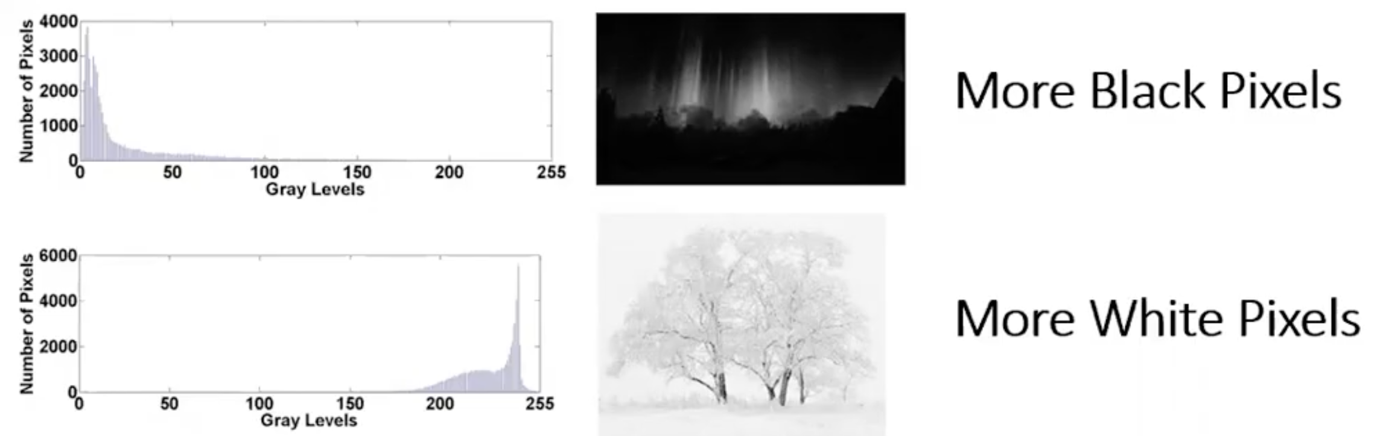
Histogram Processing and Equalization
Graphical Representation of an image .
It shows number of pixel per Gray level.

Slide 26
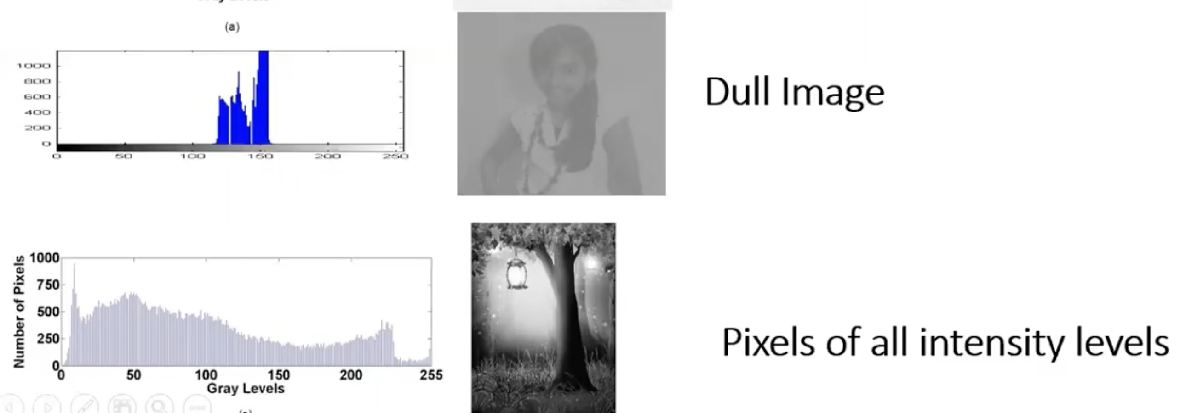
Histogram Processing and Equalization

Slide 27
Histogram Processing and Equalization
Applications of Histograms
In digital image processing, histograms are used for simple calculations in software.
It is used to analyse an image
The brightness of the image can be adjusted by having the details of its histogram.
The contrast of the image can be adjusted according to the need by having details of the x-axis of a histogram.
It is used for image equalization.
Histograms are used in thresholding as it improves the appearance of the image.

Slide 28
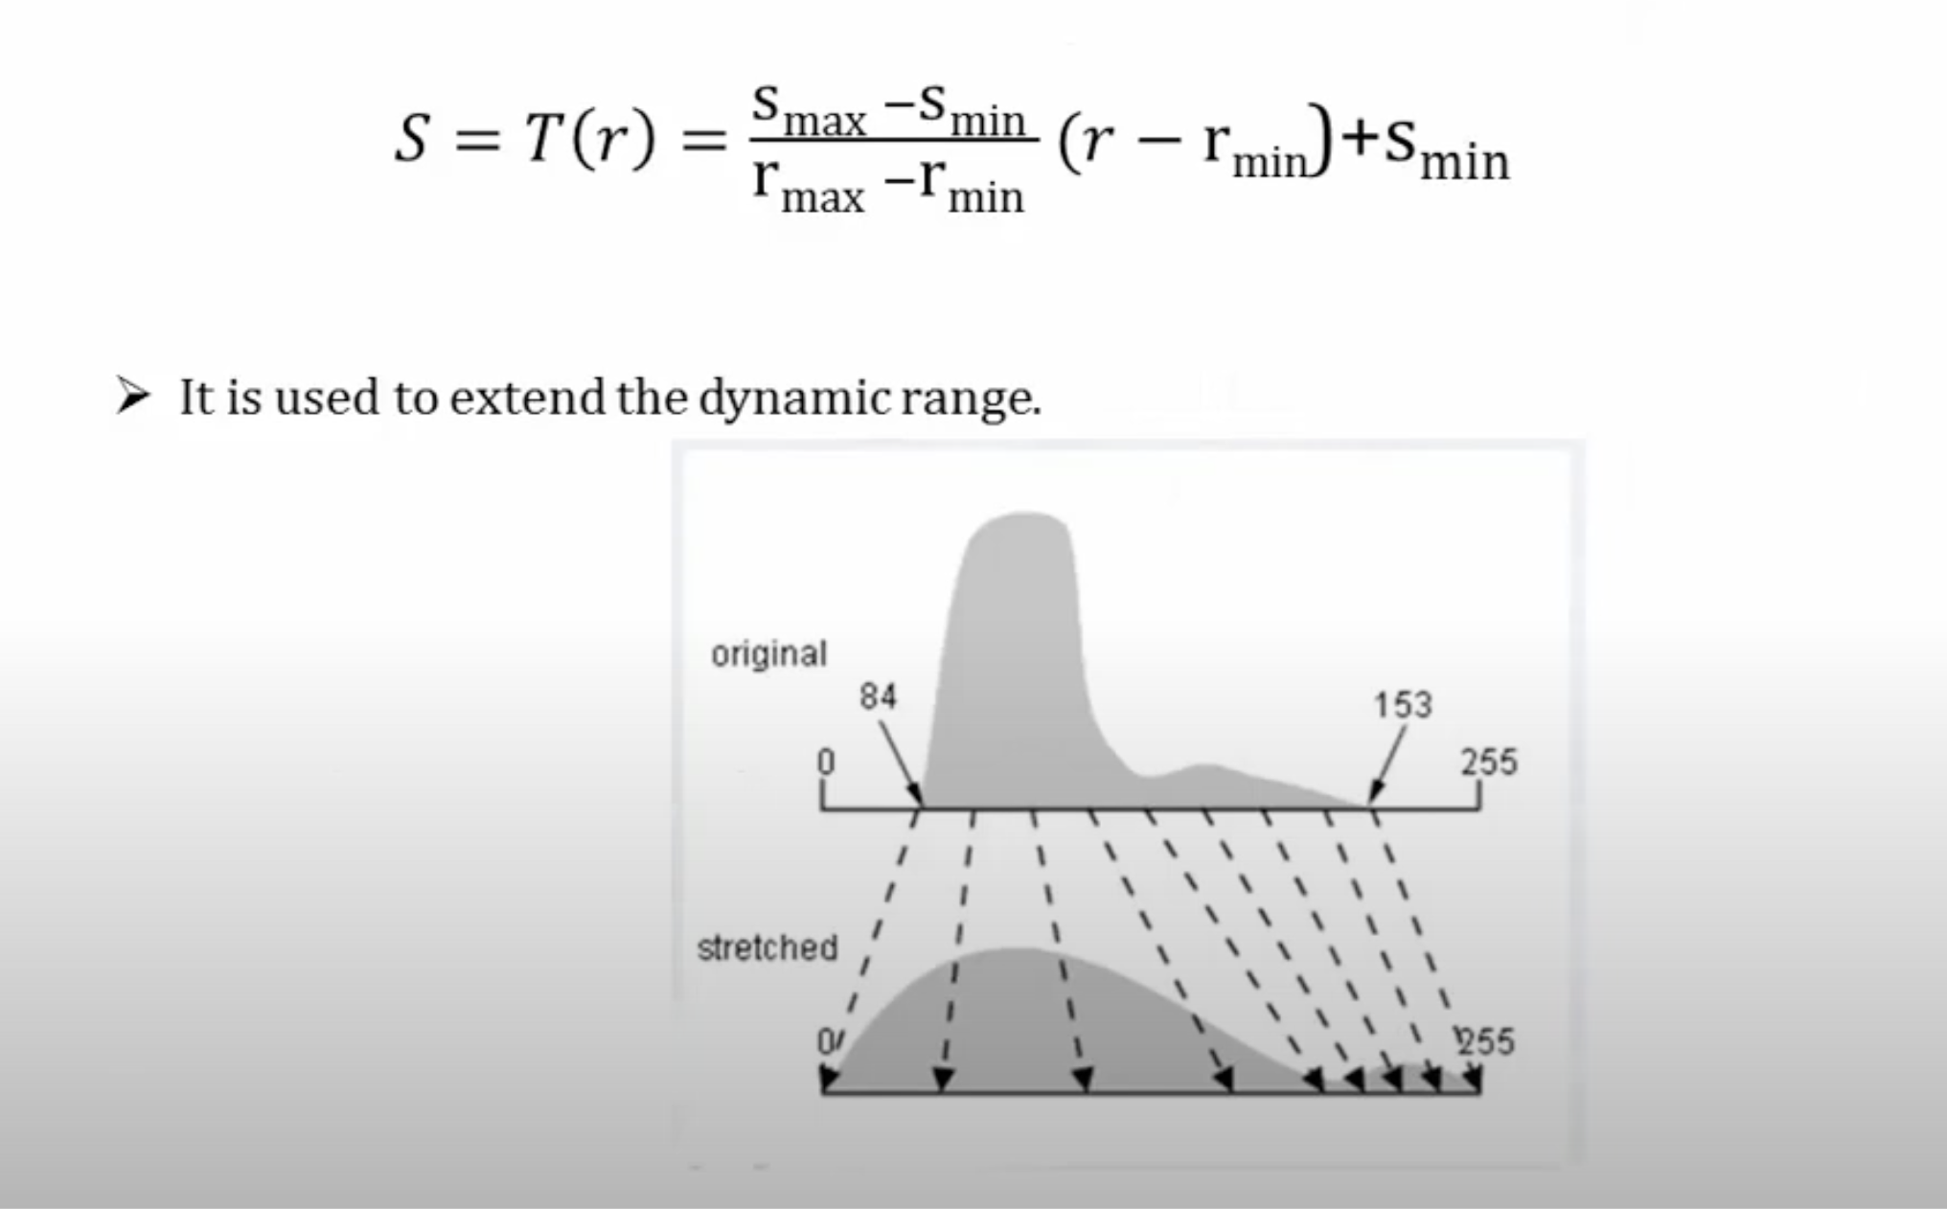
Techniques in Histogram
1. Histogram Stretching/Linear Stretching

Slide 29
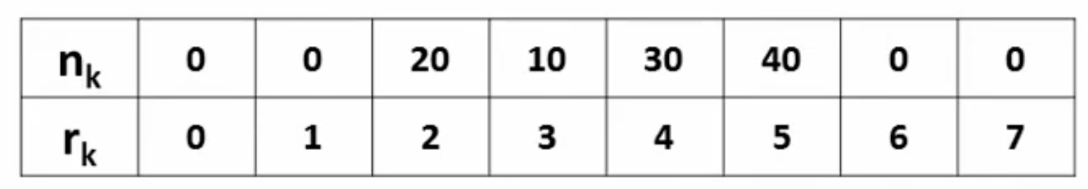
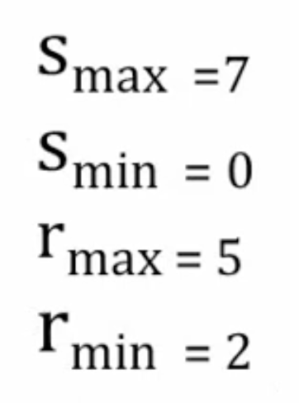
Techniques in Histogram
1. Histogram Stretching/Linear Stretching

Slide 30
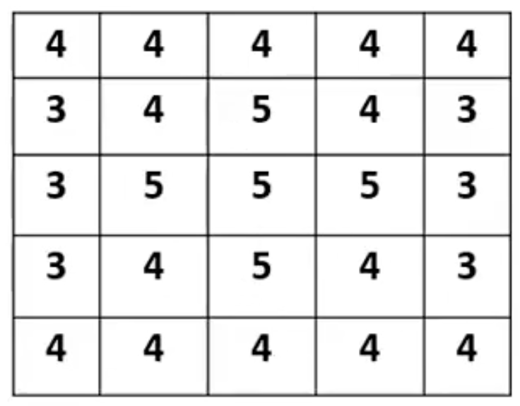
Techniques in Histogram
1. Histogram Stretching/Linear Stretching

Slide 31
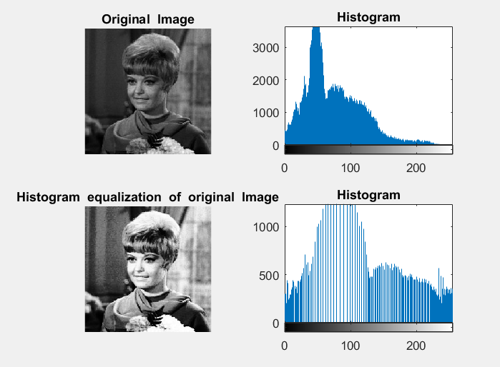
Techniques in Histogram
2. Histogram Equalization/Linearization

Slide 32
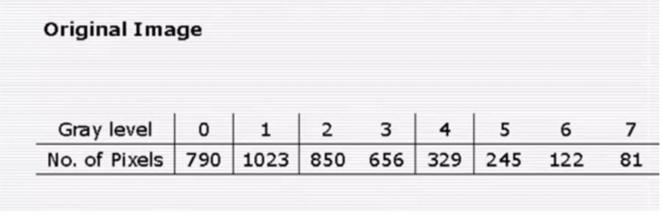
Techniques in Histogram
2. Histogram Equalization/Linearization

Slide 33
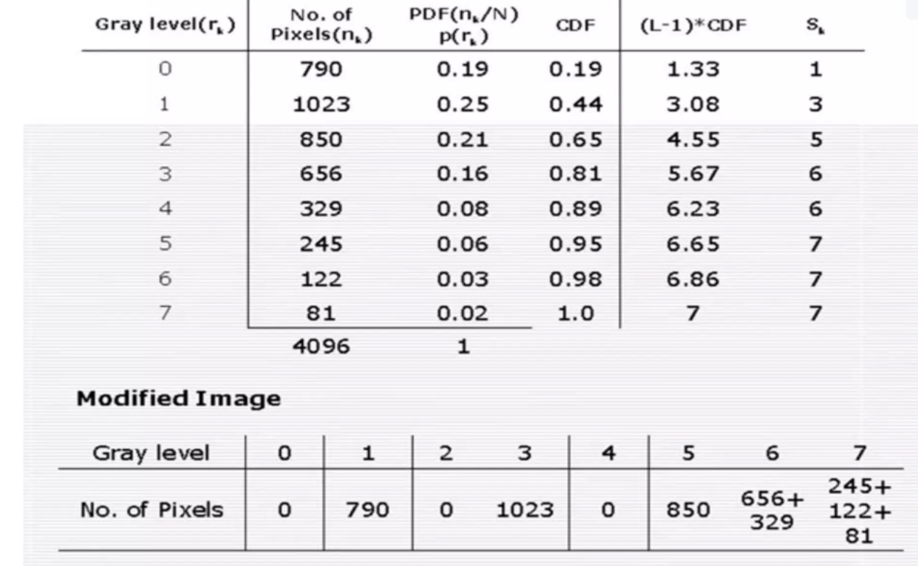
Techniques in Histogram
2. Histogram Equalization/Linearization

Slide 34
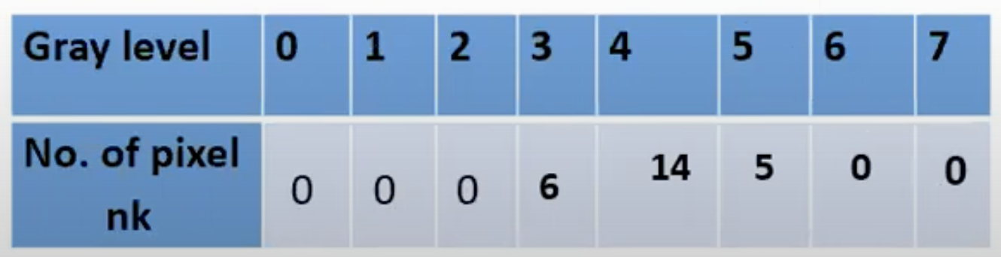
Techniques in Histogram
2. Histogram Equalization/Linearization

Slide 35
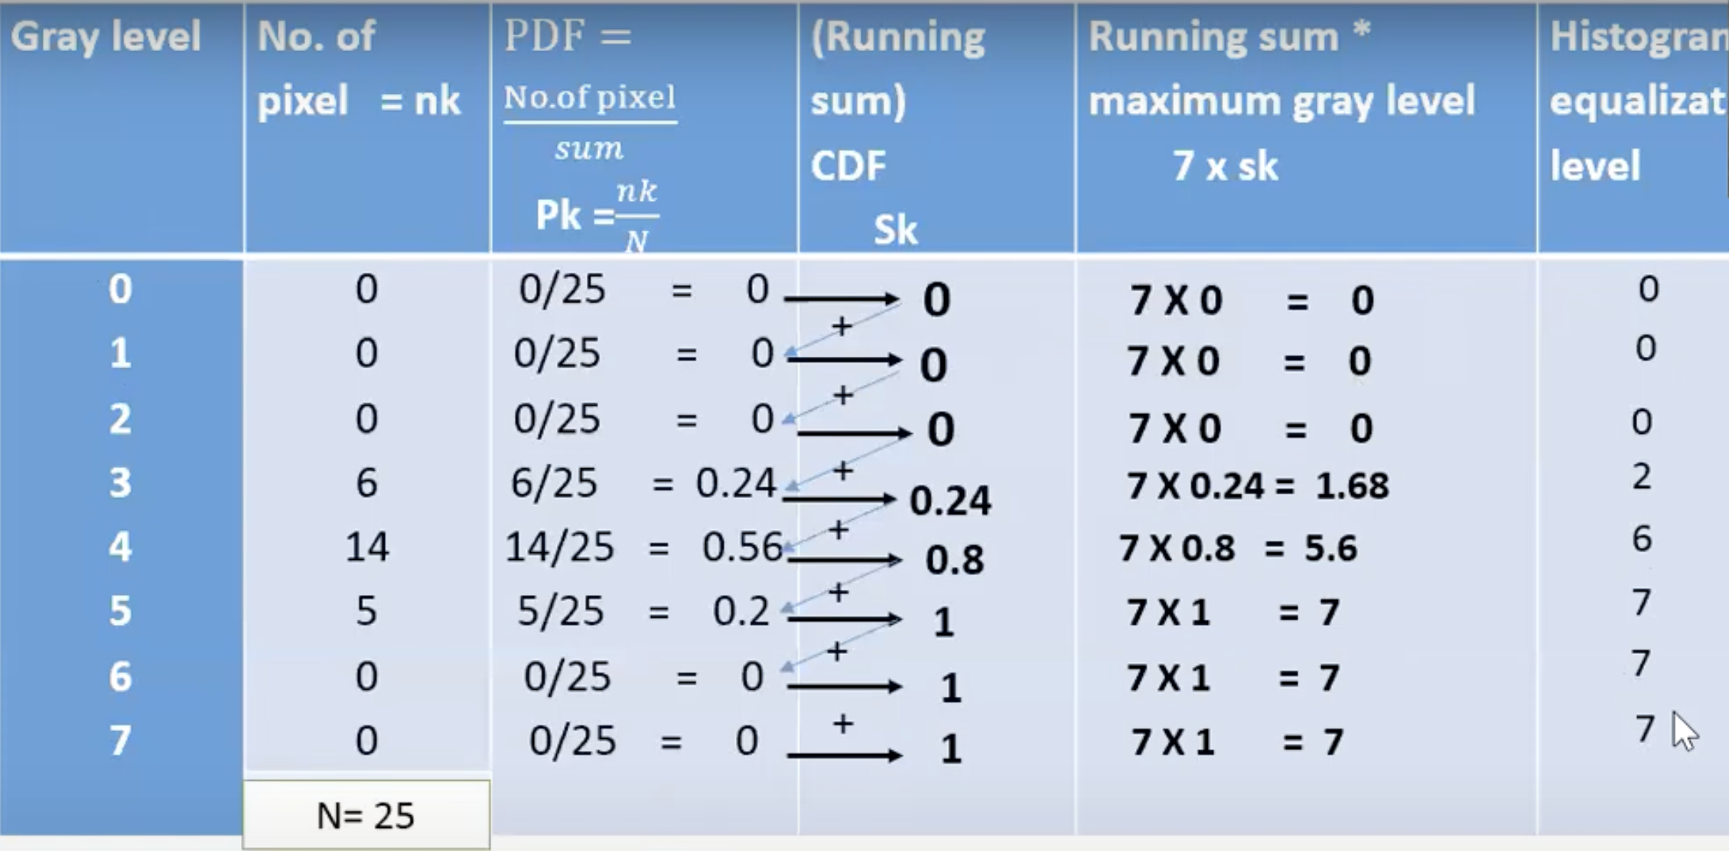
Techniques in Histogram
2. Histogram Equalization/Linearization

Slide 36
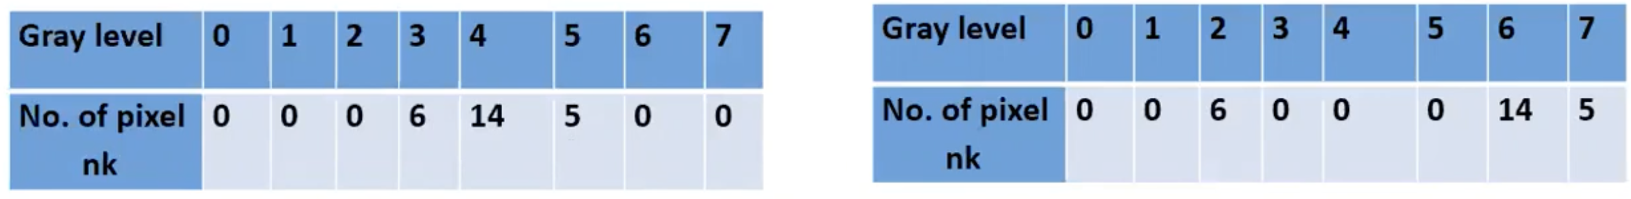
Techniques in Histogram
2. Histogram Equalization/Linearization

Slide 37
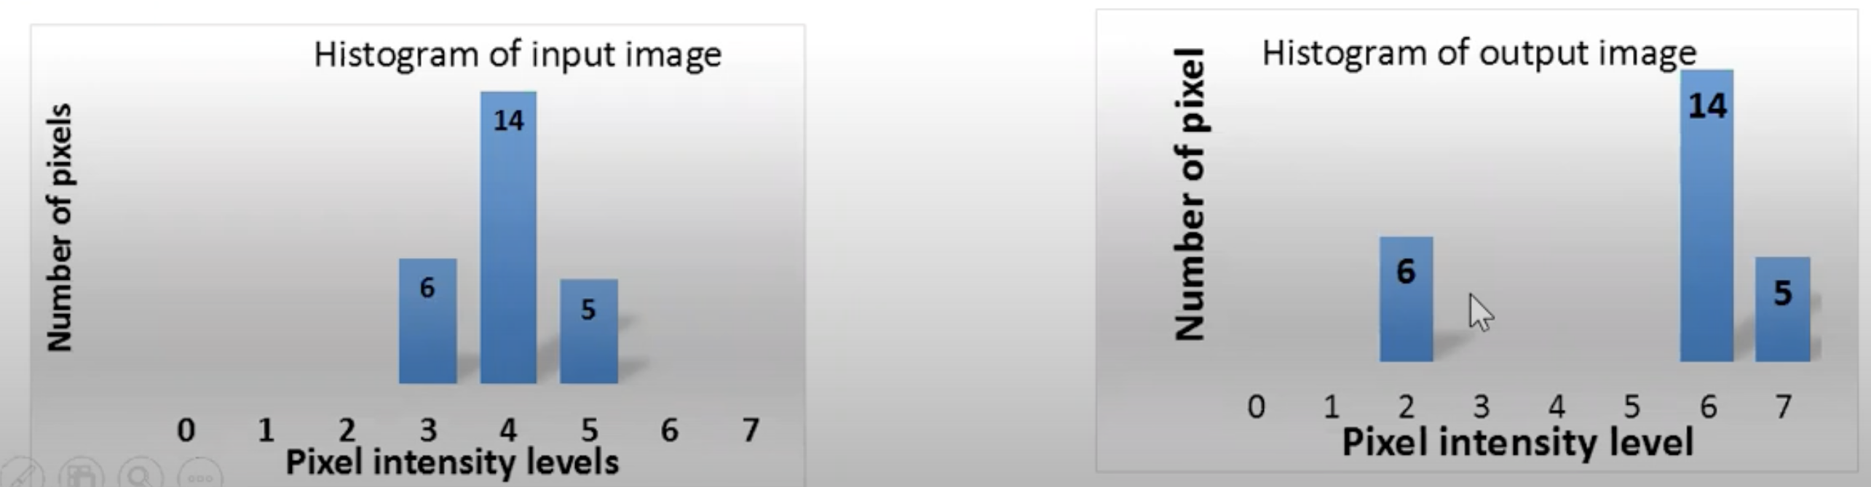
Techniques in Histogram
2. Histogram Equalization/Linearization

Slide 38
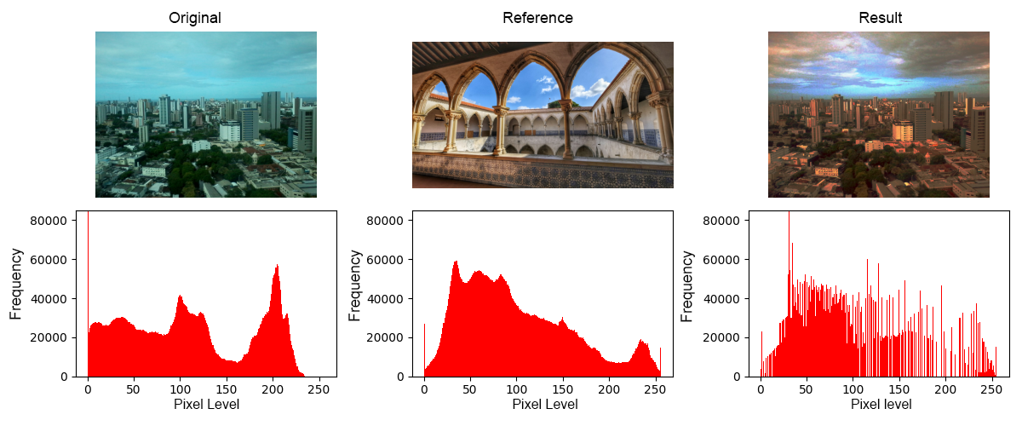
Techniques in Histogram
3. Histogram Specification/Matching

Slide 39
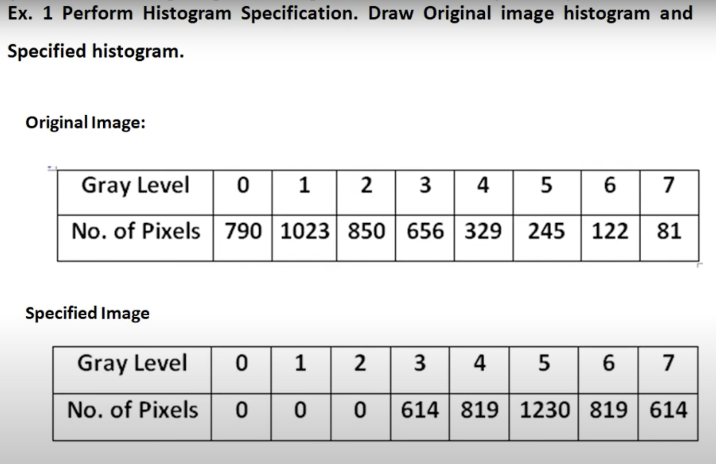
Techniques in Histogram
3. Histogram Specification/Matching

Slide 40
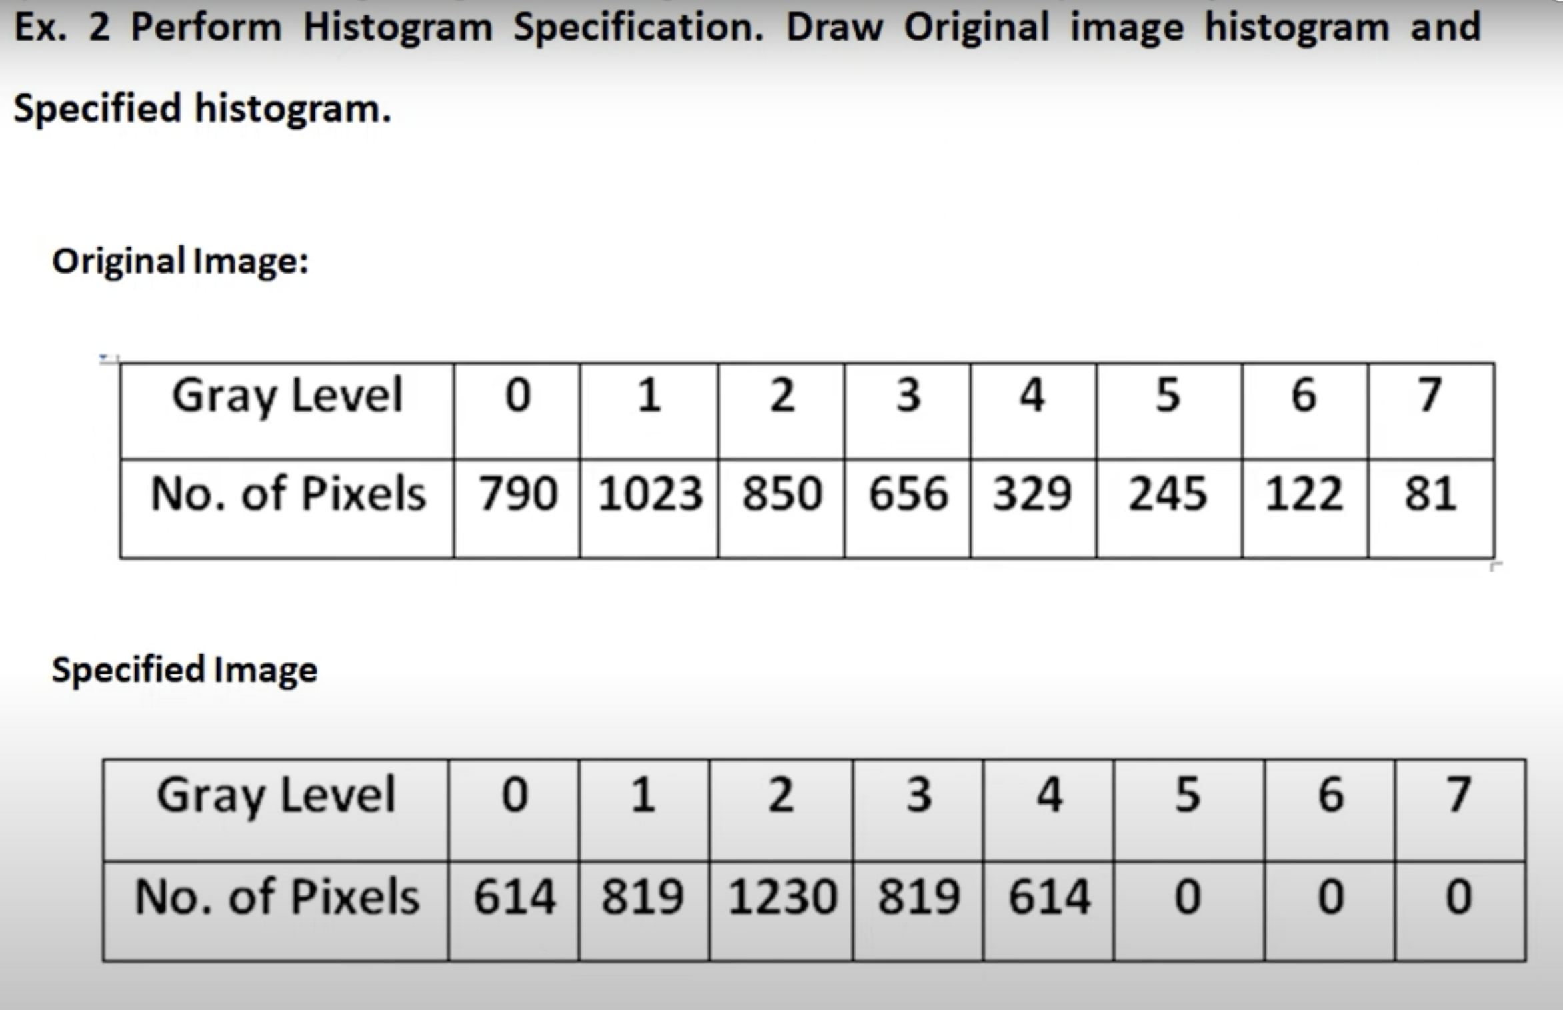
Techniques in Histogram
3. Histogram Specification/Matching

Slide 41
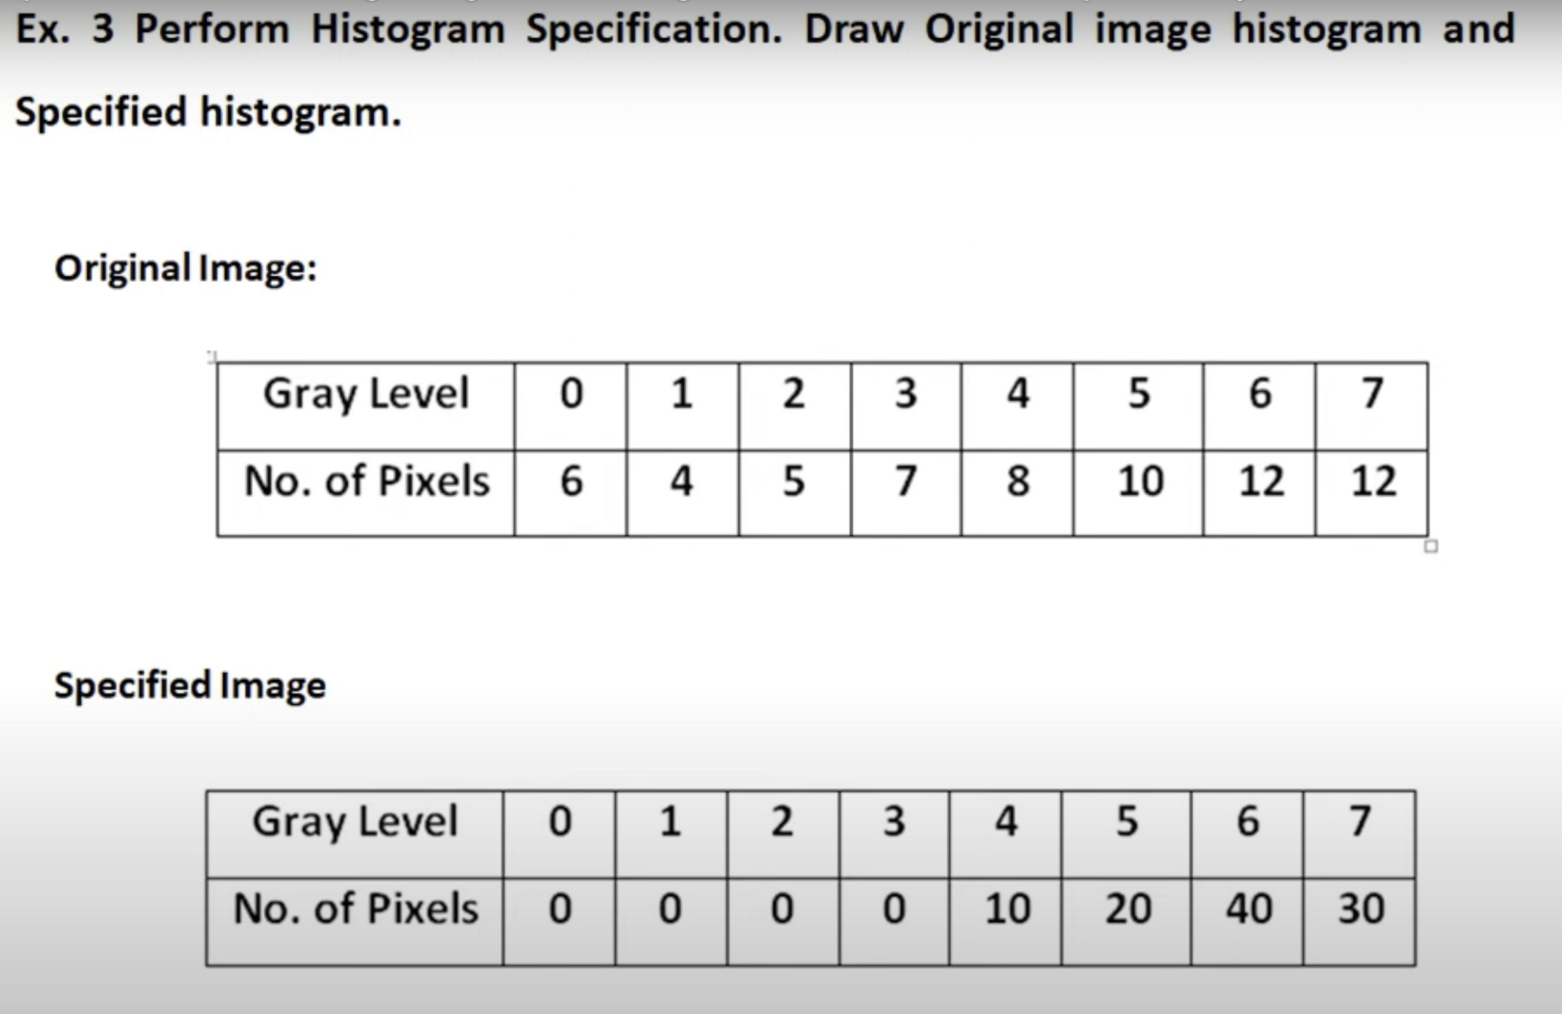
Techniques in Histogram
3. Histogram Specification/Matching

Slide 42
Smoothening and Sharpening Spatial Filters
A smoothing filter (also called a low-pass filter) is used in image processing to reduce noise, blur the image, and remove fine detail.
It replaces each pixel's value with some average of its neighbors to make transitions between pixel values smoother.
1. Average (Mean) Filtering
Idea: Replace each pixel value with the average of the surrounding pixels (including itself).
Kernel Example:
Kernel=19[111111111]
Effect: Simple blurring. Reduces random noise, but edges become less sharp.
2. Weighted Average Filtering (Gaussian Smoothing)
Idea: Give more weight to the center pixel and less weight to farther neighbors.
Kernel Example (Gaussian Filter):
Kernel=116[121242121]
Effect: Smooths while preserving more structure.
3. Median Filtering (non-linear smoothing)
Idea: Replace each pixel with the median value of its neighbors.
Operation:
Take the 3×3 neighborhood.
Sort the pixel values.
Pick the median.
Effect: Removes salt-and-pepper noise (random black and white dots) very effectively

Slide 43
Smoothening and Sharpening Spatial Filters
1. Low-Pass Filter (LPF)
Purpose:
Blurs the image
Removes high-frequency components (sharp edges, noise)
Preserves low-frequency components (smooth transitions)
Applications:
Noise reduction
Smoothing
Background enhancement
2. High-Pass Filter (HPF)
Purpose:
Enhances edges and fine details
Removes low-frequency components (background, smooth areas)
Passes high-frequency components (sharp transitions)
Applications:
Edge detection
Feature extraction
Sharpening

Slide 44
Smoothening and Sharpening Spatial Filters
3.Band-Pass Filter
Band-pass filter is used to preserve features (frequencies) within a certain range while suppressing both low-frequency (smooth/slow changes) and high-frequency (sharp noise) components.
Removes low-frequency components: Background, smooth illumination
Removes high-frequency components: Noise, fine texture
Keeps mid-frequency details: Edges, shapes, patterns

Slide 45
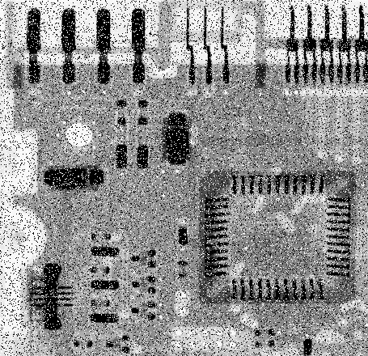
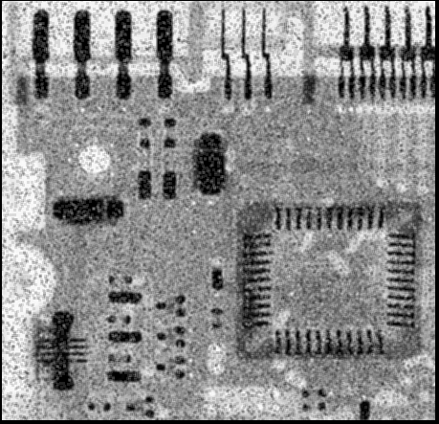
Smoothening and Sharpening Spatial Filters
Image After Applying Average Filtering
Original Image

Slide 46
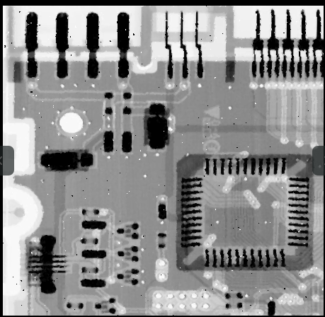
Smoothening and Sharpening Spatial Filters
Original Image
Image After Applying Median Filtering

Slide 47
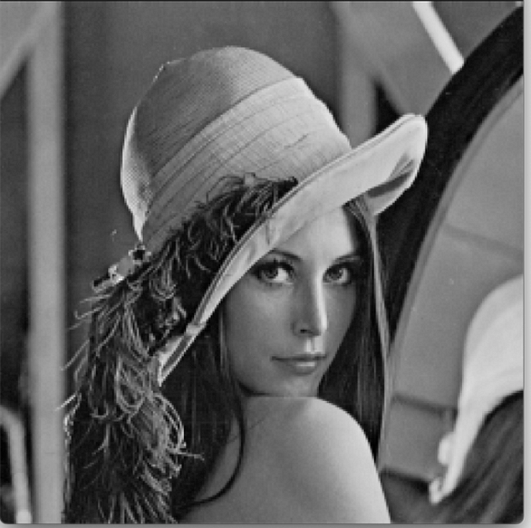
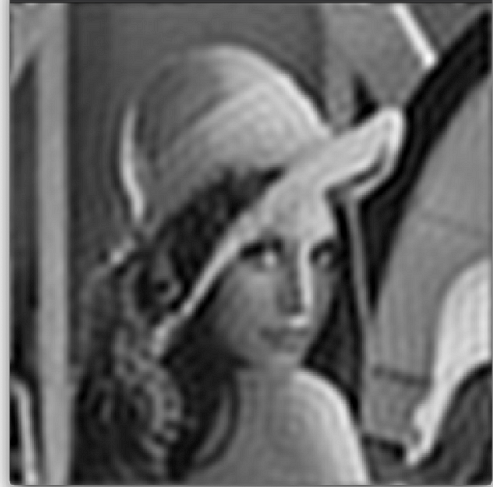
Smoothening and Sharpening Spatial Filters
Original Image
Image After Applying Low Pass Filtering

Slide 48
Smoothening and Sharpening Spatial Filters
Original Image
Image After Applying High Pass Filtering

Slide 49
Smoothening and Sharpening Spatial Filters
________
/ \
| ____ | ← Keeps mid-frequencies
\_/ \_/ ← Removes low & high
Image After Applying Band Pass Filtering

Slide 50
Magnification by replication and interpolation
Magnification is all about adding new more pixels .
The quality of the magnified image depends on how new pixel values are computed.
Original: Magnified by 2x (Replication):
[1 2] [1 1 2 2]
[3 4] [1 1 2 2]
[3 3 4 4]
[3 3 4 4]
Real-World Applications
Digital Zoom in cameras
Image resizing for websites
Medical imaging (MRI, CT magnification)
Remote sensing and satellite image enhancement

Slide 51
End of The Unit

Slide 52
THANK YOU

